Slide 1


Mobile Phone Security
Dr. Digvijaysinh Rathod
Associate Professor
(Cyber Security and Digital Forensics)
Institute of Forensic Science
Gujarat Forensic Sciences University
digvijay.rathod@gfsu.edu.in

Slide 2
Content Provider
Dr. Digvijaysinh Rathod

Slide 3
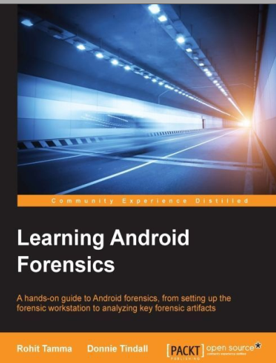
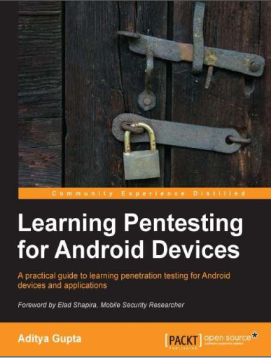
Reference
www.developer.google.com
digvijay.rathod@gfsu.edu.in

Slide 4
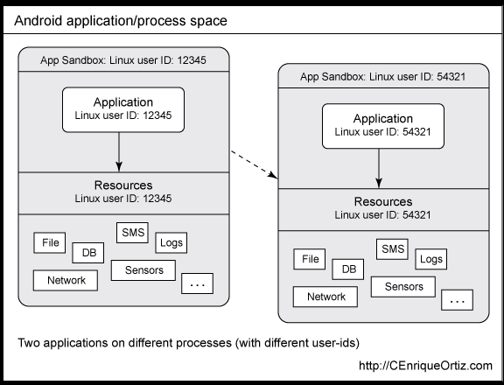
Content Provider
Dr. Digvijaysinh Rathod

Slide 5
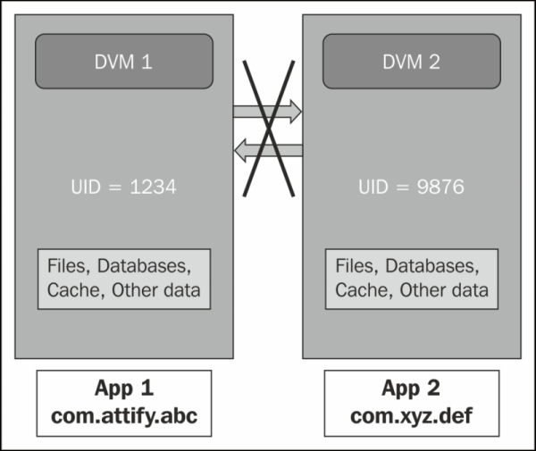
Content Provider
Dr. Digvijaysinh Rathod

Slide 6
Content Provider
Content providers provide the content/data to Android applications from an Android system or other Android applications.
Let’s go through the details of the content provider in Android, but first, let’s take a glance of topics that we will discuss:
What are Content Providers
CRUD operations
Examples
Accessing data with Content provider
Implementing Content Provider
Dr. Digvijaysinh Rathod

Slide 7
What are Content Providers in Android?
Content Providers are an important component of Android. They handle the access to the central repository and supply data from one application to another on request.
This task of handling is done by methods of ContentResolver class. So, content providers can store data in various ways such as files, database or over the internet.
Dr. Digvijaysinh Rathod

Slide 8
Content Provider
Many a time we need to share our data with applications and that’s where it becomes useful.
The following diagram depicts how the content provider helps in sharing data with applications from data stores.
Dr. Digvijaysinh Rathod

Slide 9
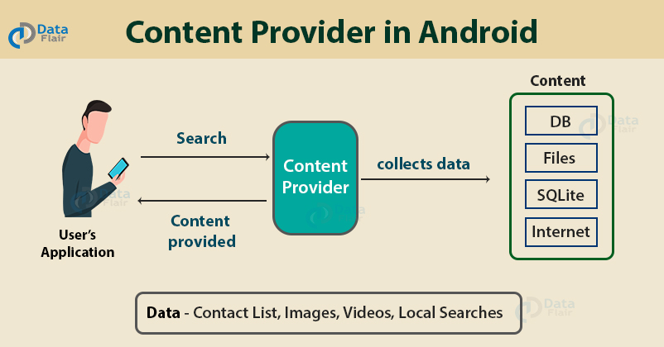
Content Provider
Dr. Digvijaysinh Rathod

Slide 10
Content Provider
As can be seen, the content provider lets us collect the data centrally and provide them to applications as shown in the above diagram.
Content providers act the same as database and also we can query it to add, delete, insert or update the data.
Dr. Digvijaysinh Rathod

Slide 11
Content Provider
It can be understood that a content provider hides the database details and also, it lets an application share data among other applications.
Content providers are not limited to texts, but also contains images and videos as well.
Dr. Digvijaysinh Rathod

Slide 12
ContentProvider
But there is a business need when one applicaiton needs to share or access data with or from system or user install application.
System Installed App
Android System
Application : 01
Contact List, Call Logs, Gallery, Music Play list etc.,
Database
Files
User Installed App
Dr. Digvijaysinh Rathod

Slide 13
Content Provider
How Does App:01 expose Data to App:02 securely ?
Application : 01
Application : 02
Data Request
A
Data Response
D
F
Android OS
Dr. Digvijaysinh Rathod

Slide 14
Content Provider
ContentProvider hides the details related to database, files etc., What does it mean App:02 request for data and content provider hides details on the App:01 side and provide detail to App:01
Application : 01
Application : 02
1
2
ContentProvider
Content Resolver
Data Request
URI
3
A
Cursur
Data Response
D
F
Android OS
Dr. Digvijaysinh Rathod

Slide 15
Content Resolver
Content Resolver: We need to use the ContentResolver object in our application, in order to communicate with the content providers for data access.
ContentRsolver resolver = getContnetResolver();
Cursor cursor = resolver.query(uri, projection, selection, selectionArgs, sortOrder);
Dr. Digvijaysinh Rathod

Slide 16
Content Resolver
The Content Resolver is the single, global instance in your application that provides access to your (and other applications’) content providers.
The Content Resolver behaves exactly as its name implies: it accepts requests from clients, and resolves these requests by directing them to the content provider with a distinct authority.
To do this, the Content Resolver stores a mapping from authorities to Content Providers.
Dr. Digvijaysinh Rathod

Slide 17
Content Resolver
The Content Resolver includes the CRUD (create, read, update, delete) methods corresponding to the abstract methods (insert, query, update, delete) in the Content Provider class.
The Content Resolver does not know the implementation of the Content Providers it is interacting with (nor does it need to know); each method is passed an URI that specifies the Content Provider to interact with.
Dr. Digvijaysinh Rathod

Slide 18
Content Resolver
Cursor cursor = getContentResolver().query(
URI, // The content URI of the words table
projection, // The columns to return for each row
selectionClause, // Selection criteria WHERE col = value
selectionArgs, // Selection criteria
sortOrder); // The sort order for the returned rows
Example Select id, name from tbl_student where id = student_id
Dr. Digvijaysinh Rathod

Slide 19
ContentProvider Authorities and URI
A content URI is a URI that identifies data in a provider. Content URIs include the symbolic name of the entire provider (its authority) and a name that points to a table (a path).
http://domain-name/data-in-the-site - Uniquer domains in http urls.
content://authority-name/data-in-the-provider
content://user_dictionary/words
where the user_dictionary string is the provider's authority, and the words string is the table's path.
Dr. Digvijaysinh Rathod

Slide 20
ContentProvider Authorities and URI
Each ContenrProvider has unique Authority and Applicaiton : 02 can resolved the content provider using content://<AuthorityName>/table-name
Application : 01
Application : 02
1
2
ContentProvider
Content Resolver
Data Request
URI
Call
UD
UserDictionary.Words.CONTENT_URI
F
CallLog.Calls.CONTENT_URI
Dr. Digvijaysinh Rathod

Slide 21
Cursor
They must be created when you are executing a SELECT statement that returns more than one row. Even though the cursor stores multiple records, only one record can be processed at a time, which is called as current row. When you fetch a row the current row position moves to next row.
Application : 01
Application : 02
ContentProvider
3
Cursor
Data Response
ID | Name
01 | Digvijay
02 | Parag
....... | ........
A
D
F
Android OS
Dr. Digvijaysinh Rathod

Slide 22
Cursor
while (cursor.moveToNext()) {
}
Dr. Digvijaysinh Rathod

Slide 23
ContentProvider Authorities and URI
Implementation of Android Services and discussion of source code.
contentprovider_contacts_example (Application will not run successfully)
Dr. Digvijaysinh Rathod

Slide 24
Mobile Phone Security
Dr. Digvijaysinh Rathod
Associate Professor
(Cyber Security and Digital Forensics)
Institute of Forensic Science
Gujarat Forensic Sciences University
digvijay.rathod@gfsu.edu.in

